Slide 1
BHOJ REDDY ENGINEERING COLLEGE FOR WOMEN DEPARTMENT OF INFORMATION TECHNOLOGY III B Tech. II Sem. A Sec. IOMP Design Seminar Academic year 2024-25 Date: 23/04 /2025 OPTIMIZED EMERGENCY BED ALLOCATION USING IOT AND AI
MP-A-17
PRESENTED
BY
K Eesha 22321A1231
R Hema Satya Varshini 22321A1236
Internal Guide
K Madhuravani
Co-Ordinator
Tasneem Rahath
HOD
Dr C Murugamani

Slide 2
CONTENTS
Introduction
Existing System
Proposed System
Modules
Functional Requirements
Non-functional Requirements
Computational resources
Technical architecture
System architecture
UML diagrams

Slide 3
PROBLEM STATEMENT
In emergency situations, patients often struggle to find hospitals with available beds and specialized doctors. Manually searching for hospitals, making phone calls, and waiting for confirmation delays critical treatment. Additionally, hospitals face difficulties in maintaining real-time updates on bed occupancy and specialist availability. To address this, an automated hospital bed assignment system is proposed that provides real-time hospital availability information, facilitates ambulance booking, and assigns hospitals based on bed and specialist availability.
Objectives:
To develop a web-based system that allows users to input their health issues and determine whether it is an emergency.
To automate the process of checking bed availability using IoT-based force sensing resistors.
To match patients with hospitals that have the necessary specialized doctors.
To provide an emergency booking option for ambulances.

Slide 4
EXISTING SYSTEM
Patients currently have to manually search for hospitals by making numerous calls or physically visiting multiple locations, which leads to delays in receiving critical care. Additionally, there is no real-time update on bed availability, making it difficult for patients to find hospitals with vacant beds. The lack of automated hospital databases further contributes to inefficiencies, as staff must manually verify and assign patients to available facilities, causing unnecessary delays. Moreover, there is no direct integration between ambulance services and hospital assignments, preventing seamless coordination in emergency situations.
Disadvantages:
Critical delays in finding hospitals with available beds.
No centralized system to check specialist availability.
Hospitals struggle to keep track of real-time bed occupancy.
Increased risk of mismanagement in emergency situations.

Slide 5
PROPOSED SYSTEM
The proposed system is a web-based application with two modules: User and Hospital. In the User Module, patients can enter their symptoms via text and the system determines if it is an emergency based on a predefined database. If an emergency is detected, users can book an ambulance, and the system checks for nearby hospitals with available beds and required specialists. Hospital details are displayed, allowing users to proceed to the recommended facility, while IoT-based force sensing resistors automatically update bed availability. The Hospital Module enables hospitals to manage bed occupancy and doctor availability, maintaining records of assigned patients and doctors. Automatic bed count updates occur through IoT sensor readings, and a real-time dashboard displays hospital data, including available beds and on-duty doctors.
Advantages:
Real-time Bed Tracking.
Quick Hospital Assignment.
Emergency Handling.
Reduced Manual Effort.

Slide 6
MODULES
1. User Module:
Symptoms input and emergency classification.
Hospital assignment based on bed and specialist availability.
Ambulance booking option.
User dashboard with hospital details.
2. Hospital Module:
Hospital login and dashboard access
Bed occupancy management via IoT sensors
Doctor availability tracking
Patient record management

Slide 7
FUNCTIONAL REQUIREMENTS
User registration and login
Symptom input through text or voice
Health issue classification
Hospital and doctor availability search
Bed availability tracking using IoT sensors
Emergency ambulance booking
Hospitals registration
Patient details management

Slide 8
NON-FUNCTIONAL REQUIREMENTS
Portability
Security
Maintainability
Performance
Reusability
Flexibility
Scalability
Performance
Usability

Slide 9
SOFTWARE REQUIREMENTS
Backend: Flask (Python), Flask-CORS, pymysql
Database: MySQL
Frontend: HTML, CSS, JavaScript
APIs: OpenStreetMap Nominatim API (for geolocation), Google Maps API (for ambulance routing)
IoT Integration: Data collection from force sensing resistors

Slide 10
HARDWARE REQUIREMENTS
Processor: Intel i3 or higher
RAM: 8GB or more
Storage: 500GB HDD or SSD
IoT Sensors: Force sensing resistors for bed occupancy tracking

Slide 11
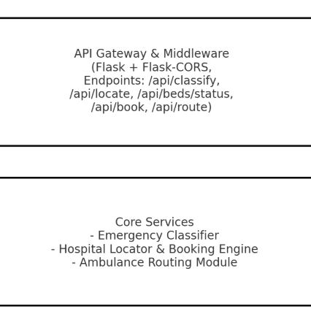




TECHNICAL ARCHITECTURE
MediQuick
HTTP Request
Client
HTTP Response
MySQL Database
Internet
IOT Devices

Slide 12
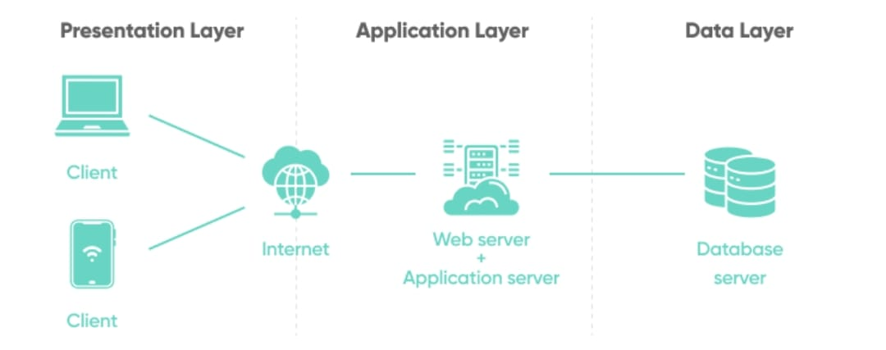

SYSTEM ARCHITECTURE
User
IoT Sensor
Hospital Management

Slide 13
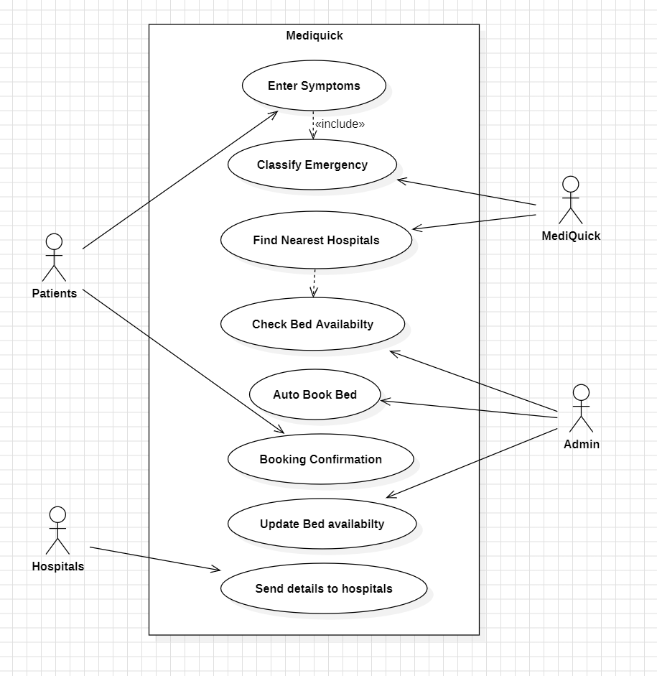
UML DIAGRAMS
Use case diagram:

Slide 14
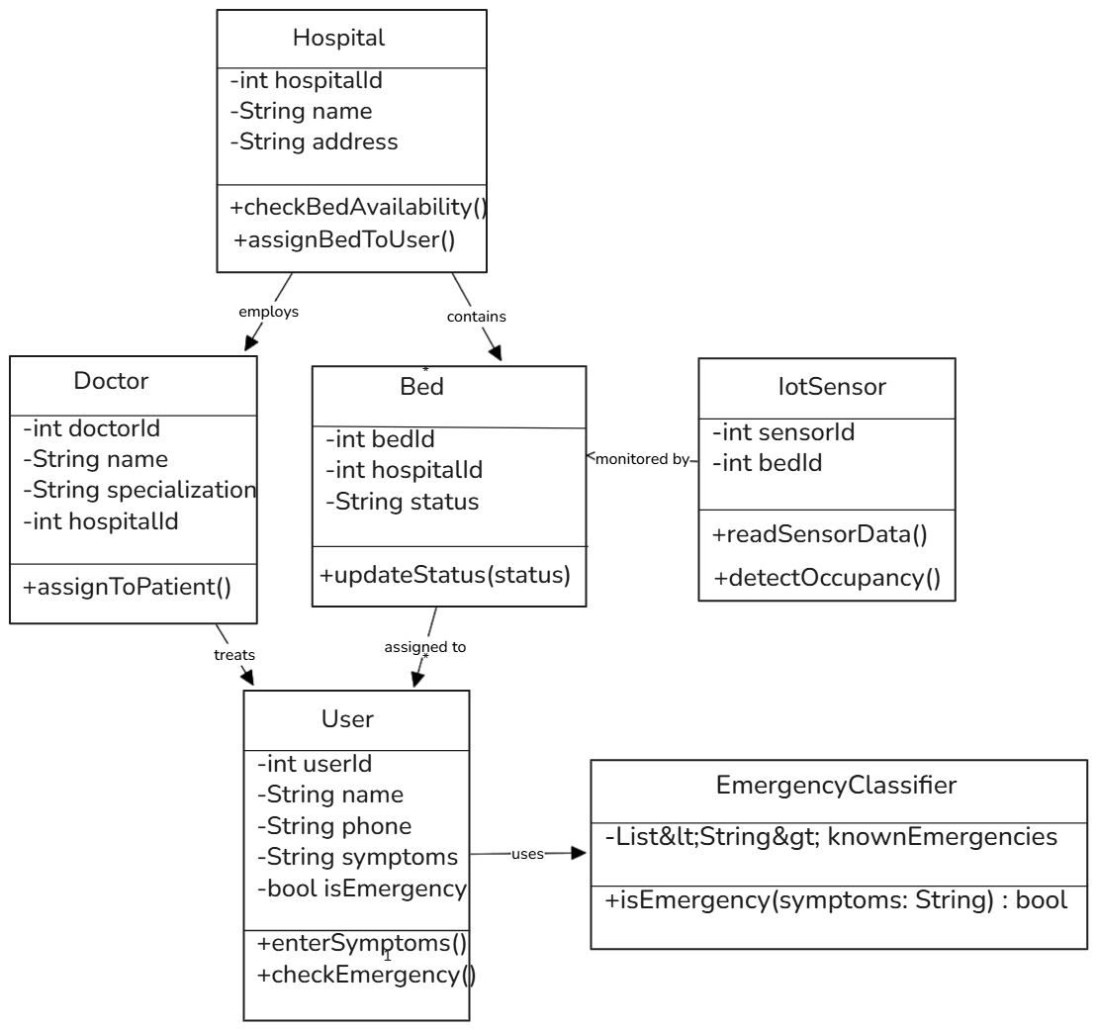
Class diagram:

Slide 15
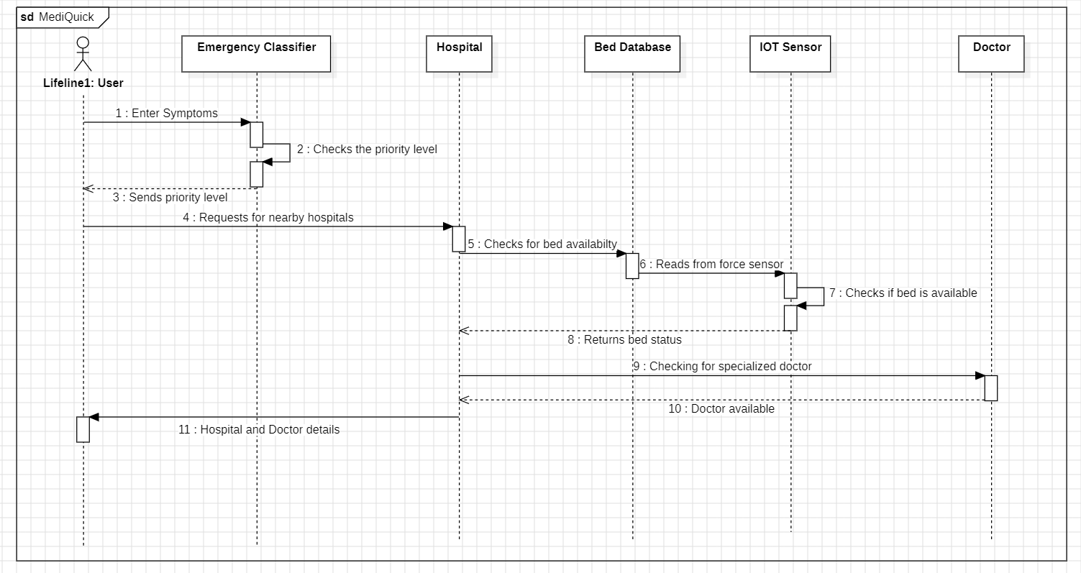
Sequence diagram:

Slide 16
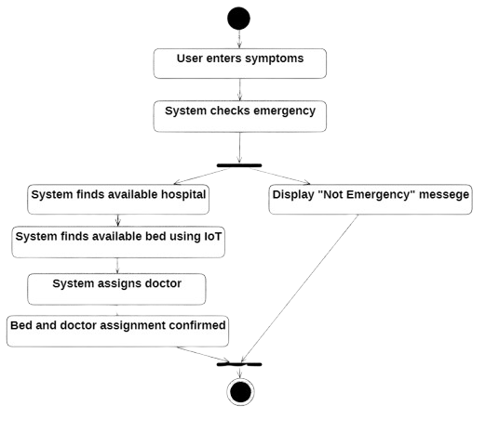
Activity diagram:

Slide 17
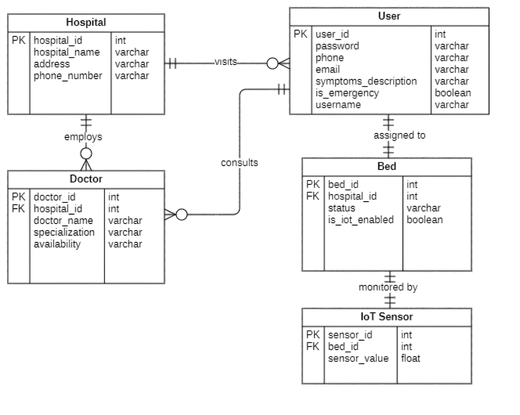
ER diagram:

Slide 18
THANK YOU!!!

